Slide 1





Teach in
England
416 656 5615
www.engage-education.com

Slide 2



What we do
Engage Education works with every type of school in the UK, including academies, Multi-Academy Trusts (MATs), independent schools, maintained schools and special schools.
We find teachers and support staff from Canada, South Africa, Australia, Ireland, Jamaica, the USA, and the UAE who want to relocate to teach in England. We assist these teachers with support and guidance, from obtaining visas to teacher training.
Covering both mainstream and SEND settings, we find teachers who are the best fit, with the right experience and qualifications, for the unique requirements of each of our partner schools.

Slide 3



Meet the team
The Engage international teams are an integral part of our support network for teachers who want to come to the UK. Teachers from North America are supported by:
Laura Hamilton
Global Talent Acquisition Manager
Kelley Potter
Executive Talent Acquisition Consultant
You will also benefit from your own personal consultant to support you here in the UK!

Slide 4

Why do Canadian teachers come to England?
The location
The UK remains a top destination for teachers from around the world who are looking for international work experience! With history everywhere you look, a globally-influential culture, mild weather and beautiful geography, a stable political and economic climate, and Europe on your doorstep, the UK provides a rich environment for teachers, full of inspiration and fun things to do.
Career Progression
Due to the teacher-short market in the UK, committed teachers can experience faster career progression in the UK than they could typically expect elsewhere. Gain international
teaching experience before returning to teach in
Canada

Slide 5




Where can you teach?
Engage Education UK coverage
  Greater London
  East of England
  Cambridgeshire
  Home Counties
  South East of England
  South West of England
  East Midlands
  Leeds
  Brighton

Slide 6

Types of work on offer
Long term roles are 6 weeks+
Mainstream
Long term and Permanent - Engage can secure you a long term or permanent role before you arrive, through online interviews. Gives you the security and stability of regular work.
Permanent = you are directly employed by the school
Short term supply - Allows you the flexibility of balancing your work and home life. Get to know the different schools you work at and this helps schools make a decision if they want to take you on a long-term permanent role.
Supply = daily supply, working in different schools
SEND
Our dedicated SEND team in the UK has fantastic relationships with a range of specialist schools for pupils with Special Education Needs and Disabilities or in mainstream schools with SEND pupils.

Slide 7

Teacher Pay
Teacher pay scales are set by the School Teachers Pay and Conditions Document (STPCD) which is legally binding in all local authority maintained schools. For classroom teachers (that is, someone who is not a head teacher, assistant head teacher, or leading practitioner) you will be paid on either the Main Pay Range or the Upper Pay Range.
Teacher pay differs based on experience and from region to region.
The pay range for classroom teachers in 2025/2026 ranges from £33,000 ( $61,000 CAD, band 1, outside of the London area) to £62,500 ($116,000 CAD, Max U3, inner London). This is the bottom of the main pay scale to the top of the upper pay scale.
All Engage teachers are paid in line with the national teacher scales.

Slide 8

The UK school year
The UK school year is split into three terms - covering September-December, January-April, and May-July, though each area will have its own specific dates for term breaks.
Each term is split into two “half terms”, which is typically marked by a week’s break. There are also breaks at Christmas and Easter, and the longest break in Summer - usually 6 weeks.
UK Schools
Term 1
September - December
Term 2
January - April
Term 3
May - July

Slide 9

Key Stages & National Curriculum
The English education system is grouped in “Key Stages”. Key Stages consist of a certain range of school years and are used to administer standardised exams during a child’s education.
Key Stage
School Years
Age Group
1
1-2
5-7
Primary
2
3-6
7-11
3
7-9
11-14
Secondary
4
10-11
14-16
The subjects covered in the UK National Curriculum are:
English, History, Art, Music, Maths, Geography,
Design & Technology, PE, Science, Languages, Computing and Citizenship

Slide 10

Working Rights
Youth Mobility Visa
  2 year visa
  Must be a commonwealth country passport holder
  Must be 35 years and under
  Costs £298, plus a fee of £776/year for the Immigration Health surcharge

Slide 11

Eligibility
UK Working Rights
British or European Passport
You currently hold, or have the rights to apply for, a British or European Passport which will allow you unlimited working rights in the UK.
If you have a grandparent who was born in England and remains or remained a British citizen, an ancestry visa will allow you to live and work in the UK. Your spouse and children would then be able to get spousal and dependants visas.
Ancestry Visa
Spousal Visa
You currently hold, or have the rights to apply for, a British or European Passport which will allow you unlimited working rights in the UK.
An option for those who aren’t eligible for any other UK Working Rights. Generally available for experienced teachers in specific subject areas such as Maths & Science.
Sponsorship
Qualifications
You need to be fully qualified to be eligible to teach in the UK. You can undertake your QTS
assessment while you teach in the UK.

Slide 12


Benefits of working with Engage
We provide benefits once you’ve arrived to work in the UK, making sure you feel supported every step of the way:
  Personalized support from your own Canadian-based consultant with former UK teaching experience
  CPD - Creative Education & CANTeach
  Community & Wellbeing - personalised care coordinated by our Community & Wellbeing Executive
  ESP Partnership - mental health and wellbeing support 24/7
  You can receive a referral bonus of £50 for recommending other teachers to us

Slide 13
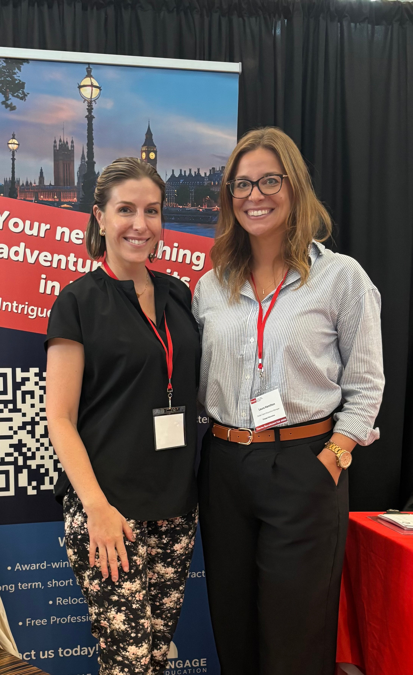
Why choose Engage?
Engage Education have been trailblazers in international education recruitment since 2008!
That’s over a decade of placing fantastic British teachers in our partner schools, and helping teachers from Canada, Ireland, Australia, New Zealand, South Africa, the UAE and other locations across the globe to make the jump to the UK. We’re continuously working to raise the standards of teaching worldwide, and that all starts with you.
We’ve helped over 1,032 international teachers from countries outside of the UK.

Slide 14









Next steps
Get in touch
416.656.5615
www.engage-education.com
canada.office@engagepartners.co.uk
Follow us on social media!

